Slide 1

Foothill Technology Solutions
Trainee Name: Asia Shalaldeh
Back-End Development
2022-2023

Slide 2
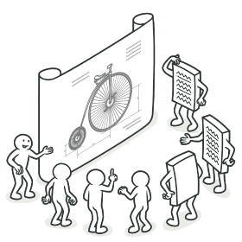
Design Patterns

Slide 3






Slide 4
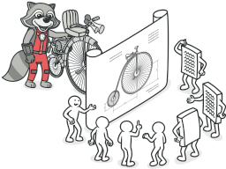
What are design patterns?
Design patterns are typical solutions to common problems in software design.

Slide 5

History of patterns

Slide 6

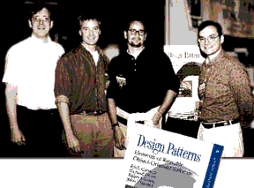
Design Patterns: Elements of Reusable Object-Oriented Software

Slide 7
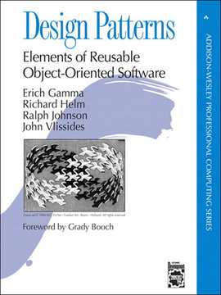
“The GoF Book”

Slide 8
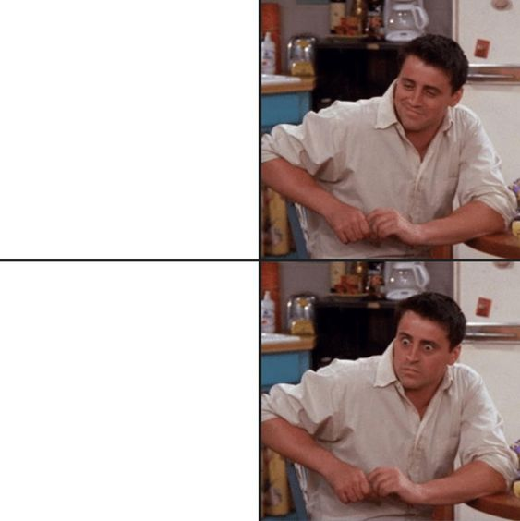
Benefits of Design Patterns
Reusability
Better collaboration
Improved maintainability
Faster development time
Improved code quality

Slide 9
Criticism of patterns
Kludges for a weak programming language
Inefficient solutions “dogma”
Unjustified use
“If all you have is a hammer,
everything looks like a nail”

Slide 10
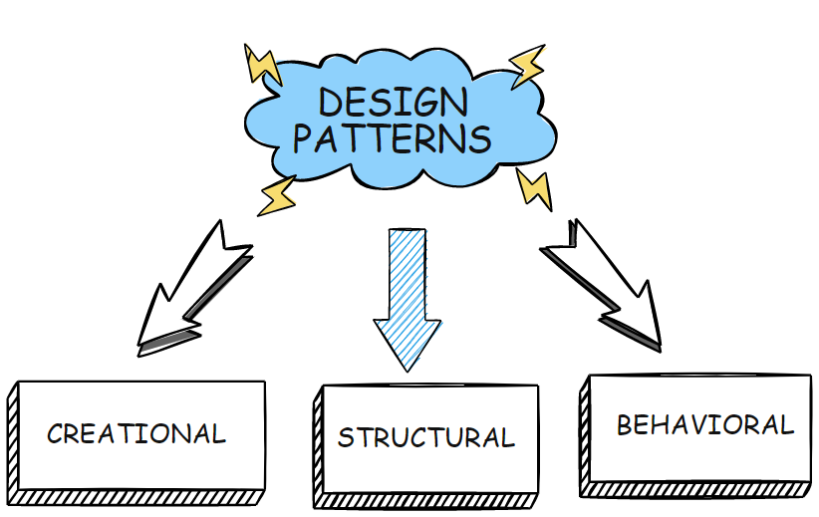

Slide 11
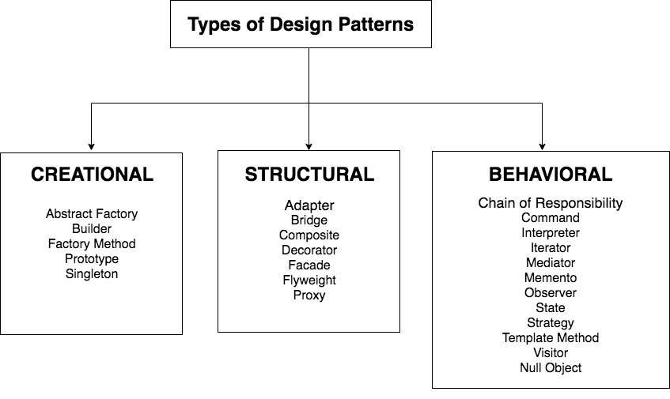

Slide 12






Definition
Problem
Solution
Structure
Real-World Analogy + Code
Applicability

Slide 13
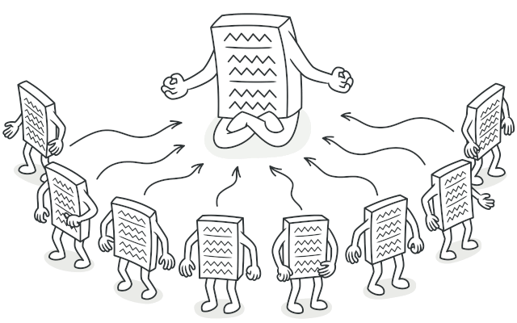
Singleton (Creational)

Slide 14
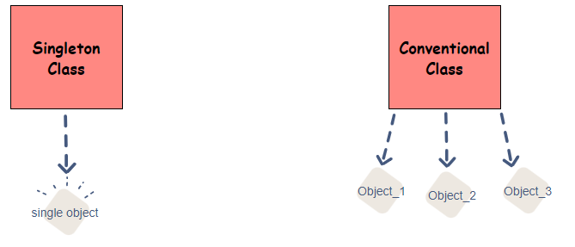

Slide 15
Problem
1- Ensure that a class has just a single instance
It is impossible to implement with a regular constructor
2- Provide a global access point to that instance

Slide 16
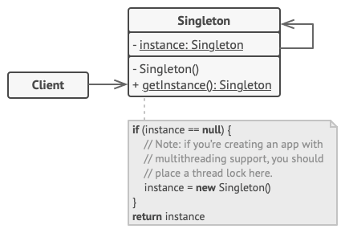
Solution
1- Make the default constructor private
2- Create a static creation method that acts as a constructor.

Slide 17
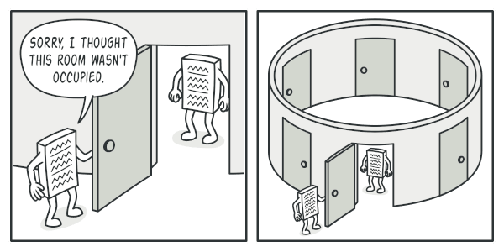
Clients may not even realize that they’re working with the same object all the time

Slide 18
Coding Time

Slide 19
Applicability
Use the Singleton pattern when a class in your program should have just a single instance available to all clients, for example, a single database object shared by different parts of the program.
Use the Singleton pattern when you need stricter control over global variables.

Slide 20

Scenarios:
1- Database connection
2- Logger

Slide 21


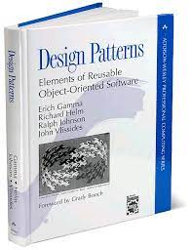
Further Reading

Slide 22


